Slide 1
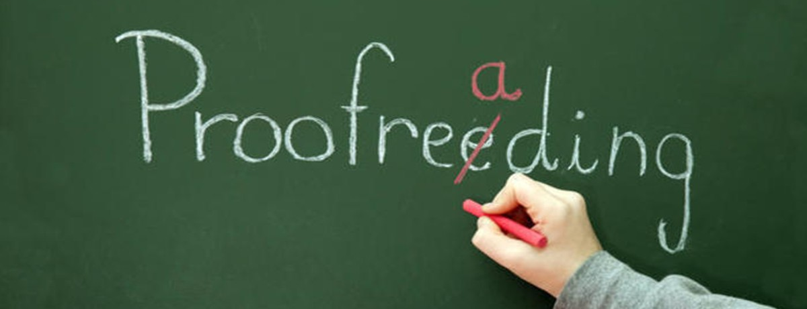
In this matter I will give you advice that will help you. One year ago, you not only started to do something, but you desired to do it. Now finish it. Just as there was an eagerness and desire to do it then, may you also bring it to completion, as much as you can (2 Cor. 8:10-11).
All Scripture taken from the English Unlocked Literal Bible (ULB), ©2017, 2022 Wycliffe Associates, Available at https://bibleineverylanguage.org/translations, licensed under the Creative Commons Attribution-ShareAlike 4.0 International License.
The English ULB is based on the unfoldingWord® Literal Text, CC BY-SA 4.0. The original work of the unfoldingWord® Literal Text is available at https://unfoldingword.bible/ult/.
Proofreading
and Publication

Slide 2
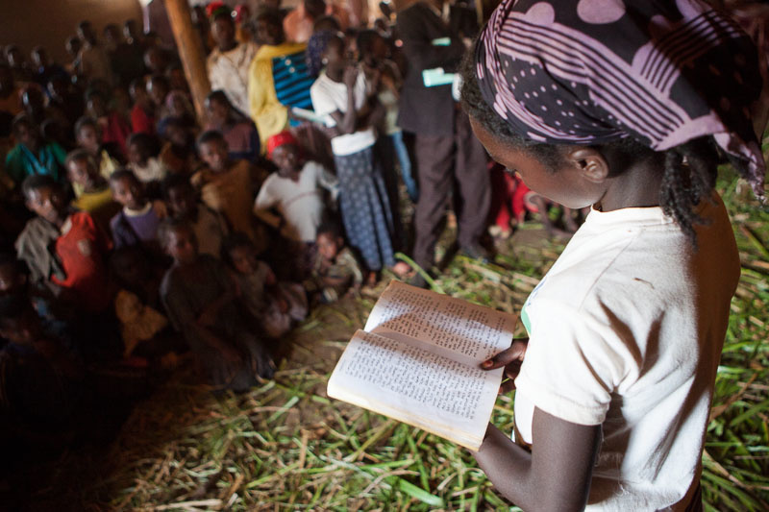

Written Publication
Print
Digital

Slide 3


Print Workflow Details
Upload clean files to the repository.
Request Printing via your WA contact.
WA Team converts repos to USFM and does initial “cleaning.”
WA Team reviews issues and submits unresolved issues back to church partner.
Translation team reviews issues and uploads revisions.
WA Team produces PDF.
Church partner reviews PDF (corrections made if needed).
PDF approved. Final PDF sent to printer.
Minimum: 4 Months

Slide 4

Proofreading:
The Last Step Before Uploading
Proofreading finds mostly typing errors.
These errors may affect meaning.

Slide 5
How Punctuation Changes Meaning
Call me Pat.

Slide 6
How Punctuation Changes Meaning
Call me Pat.
Call me, Pat.

Slide 7
How Punctuation Changes Meaning
I’m sorry I love you.

Slide 8
How Punctuation Changes Meaning
I’m sorry I love you.
I’m sorry. I love you.

Slide 9
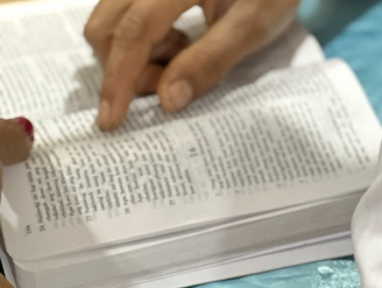
Proofreading and Community Acceptance
Correct typing and format are evidence of a quality translation.

Slide 10
From Galatians 5:
22But the fruit OF the spirit is love joy) peace, patience, Kindness, goodness, Faith, gentleness, and selfcontrol against such things there is no law . 24 those who belong to christ Jesus have cRucified the flesh with its passionsa nd desires²⁵ If we live by the Spirit, let us also walk” by thespirit?
²² But the fruit of the Spirit is love, joy, peace, patience, kindness, goodness, faith, ²³ gentleness, and self-control; against such things there is no law. ²⁴ Those who belong to Christ Jesus have crucified the flesh with its passions and desires. ²⁵ If we live by the Spirit, let us also walk by the Spirit.

Slide 11
From Galatians 5: Beginnings of Sentences
22But the fruit OF the spirit is love joy) peace, patience, Kindness, goodness, Faith, gentleness, and selfcontrol against such things there is no law . 24 those who belong to christ Jesus have cRucified the flesh with its passionsa nd desires²⁵ If we live by the Spirit, let us also walk” by thespirit?

Slide 12
From Galatians 5: Beginnings of Sentences
22But the fruit OF the spirit is love joy) peace, patience, Kindness, goodness, Faith, gentleness, and selfcontrol against such things there is no law . 24 those who belong to christ Jesus have cRucified the flesh with its passionsa nd desires²⁵ If we live by the Spirit, let us also walk” by thespirit?
²² But the fruit of the Spirit is love, joy, peace, patience, kindness, goodness, faith, ²³ gentleness, and self-control; against such things there is no law. ²⁴ Those who belong to Christ Jesus have crucified the flesh with its passions and desires. ²⁵ If we live by the Spirit, let us also walk by the Spirit.

Slide 13
From Galatians 5: Endings of Sentences
22But the fruit OF the spirit is love joy) peace, patience, Kindness, goodness, Faith, gentleness, and selfcontrol against such things there is no law . 24 those who belong to christ Jesus have cRucified the flesh with its passionsa nd desires²⁵ If we live by the Spirit, let us also walk” by thespirit?

Slide 14
From Galatians 5: Endings of Sentences
22But the fruit OF the spirit is love joy) peace, patience, Kindness, goodness, Faith, gentleness, and selfcontrol against such things there is no law . 24 those who belong to christ Jesus have cRucified the flesh with its passionsa nd desires²⁵ If we live by the Spirit, let us also walk” by thespirit?
²² But the fruit of the Spirit is love, joy, peace, patience, kindness, goodness, faith, ²³ gentleness, and self-control; against such things there is no law. ²⁴ Those who belong to Christ Jesus have crucified the flesh with its passions and desires. ²⁵ If we live by the Spirit, let us also walk by the Spirit.

Slide 15
From John 6: Quotation Marks
⁶⁷ Then Jesus said to the twelve, “You do not want to go away also, do you?” ⁶⁸ Simon Peter answered him, “Lord, to whom would we go? You have words of eternal life, ⁶⁹ and we have believed and come to know that you are the Holy One of God.”
⁶⁷ Así que Jesús preguntó a los doce:
—¿También ustedes quieren marcharse?
⁶⁸ —Señor —contestó Simón Pedro—, ¿a quién iremos? Tú tienes palabras de vida eterna. ⁶⁹ Y nosotros hemos creído, y sabemos que tú eres el Santo de Dios.

Slide 16
From Galatians 5: Should There Be Quotation Marks?
22But the fruit OF the spirit is love joy) peace, patience, Kindness, goodness, Faith, gentleness, and selfcontrol against such things there is no law . 24 those who belong to christ Jesus have cRucified the flesh with its passionsa nd desires²⁵ If we live by the Spirit, let us also walk” by thespirit?
²² But the fruit of the Spirit is love, joy, peace, patience, kindness, goodness, faith, ²³ gentleness, and self-control; against such things there is no law. ²⁴ Those who belong to Christ Jesus have crucified the flesh with its passions and desires. ²⁵ If we live by the Spirit, let us also walk by the Spirit.

Slide 17
From John 6: Parentheses
¹ After these things, Jesus went away to the other side of the Sea of Galilee, also called the Sea of Tiberias. ² A great crowd was following him because they saw the signs that he was doing on those who were sick. ³ Jesus went up the mountain and there he sat down with his disciples. ⁴ (Now the Passover, the Jewish festival, was near.) ⁵ When Jesus looked up and saw a great crowd coming to him, he said to Philip, "Where are we going to buy bread so that these may eat?" ⁶ (But Jesus said this to test Philip, for he himself knew what he was going to do.)

Slide 18
From Galatians 5: Should There Be Parentheses?
22But the fruit OF the spirit is love joy) peace, patience, Kindness, goodness, Faith, gentleness, and selfcontrol against such things there is no law . 24 those who belong to christ Jesus have cRucified the flesh with its passionsa nd desires²⁵ If we live by the Spirit, let us also walk” by thespirit?
²² But the fruit of the Spirit is love, joy, peace, patience, kindness, goodness, faith, ²³ gentleness, and self-control; against such things there is no law. ²⁴ Those who belong to Christ Jesus have crucified the flesh with its passions and desires. ²⁵ If we live by the Spirit, let us also walk by the Spirit.

Slide 19
From Galatians 5: Capitalization (Names and Places in English)
22But the fruit OF the spirit is love joy) peace, patience, Kindness, goodness, Faith, gentleness, and selfcontrol against such things there is no law . 24 those who belong to christ Jesus have cRucified the flesh with its passionsa nd desires²⁵ If we live by the Spirit, let us also walk” by thespirit?

Slide 20
From Galatians 5: Capitalization (Names and Places in English)
22But the fruit OF the spirit is love joy) peace, patience, Kindness, goodness, Faith, gentleness, and selfcontrol against such things there is no law . 24 those who belong to christ Jesus have cRucified the flesh with its passionsa nd desires²⁵ If we live by the Spirit, let us also walk” by thespirit?
²² But the fruit of the Spirit is love, joy, peace, patience, kindness, goodness, faith, ²³ gentleness, and self-control; against such things there is no law. ²⁴ Those who belong to Christ Jesus have crucified the flesh with its passions and desires. ²⁵ If we live by the Spirit, let us also walk by the Spirit.

Slide 21
From Galatians 5: Miscellaneous
22But the fruit OF the spirit is love joy) peace, patience, Kindness, goodness, Faith, gentleness, and selfcontrol against such things there is no law . 24 those who belong to christ Jesus have cRucified the flesh with its passionsa nd desires²⁵ If we live by the Spirit, let us also walk” by thespirit?

Slide 22
From Galatians 5: Miscellaneous
22But the fruit OF the spirit is love joy) peace, patience, Kindness, goodness, Faith, gentleness, and selfcontrol against such things there is no law . 24 those who belong to christ Jesus have cRucified the flesh with its passionsa nd desires²⁵ If we live by the Spirit, let us also walk” by thespirit?
²² But the fruit of the Spirit is love, joy, peace, patience, kindness, goodness, faith, ²³ gentleness, and self-control; against such things there is no law. ²⁴ Those who belong to Christ Jesus have crucified the flesh with its passions and desires. ²⁵ If we live by the Spirit, let us also walk by the Spirit.

Slide 23
From Galatians 5: Proper Number of Verses
22But the fruit OF the spirit is love joy) peace, patience, Kindness, goodness, Faith, gentleness, and selfcontrol against such things there is no law . 24 those who belong to christ Jesus have cRucified the flesh with its passionsa nd desires²⁵ If we live by the Spirit, let us also walk” by thespirit?

Slide 24
From Galatians 5: Proper Number of Verses
22But the fruit OF the spirit is love joy) peace, patience, Kindness, goodness, Faith, gentleness, and selfcontrol against such things there is no law . 24 those who belong to christ Jesus have cRucified the flesh with its passionsa nd desires²⁵ If we live by the Spirit, let us also walk” by thespirit?
²² But the fruit of the Spirit is love, joy, peace, patience, kindness, goodness, faith, ²³ gentleness, and self-control; against such things there is no law. ²⁴ Those who belong to Christ Jesus have crucified the flesh with its passions and desires. ²⁵ If we live by the Spirit, let us also walk by the Spirit.

Slide 25
Try it

